Slide 1
Study Update: From Generic Interaction Analysis to a Focused Monetization Study
Earlier setup
Generic binary feature pairs
~10 countries
Framework demonstration
Current study
F2P monetization × genre
42 markets × 14 months
Contextual validity
Resulting story
Forms of play + markets
Interaction framework
Cultural Paradox of Success
1

Slide 2
Current Research Question
Monetization
Ads / IAP
Gameplay Context
Genre / form of play
Marketplace Success
Installs / ratings
Does genre modify the relationship between Ads/IAP and marketplace success — and do the resulting patterns generalize across markets and remain stable over time?
3

Slide 3
Hormonal Replacement Therapy (HRT) to CHD
Does HRT affect coronary heart disease (CHD) risk?
split by Sex
Female?
Male?
split by Age
Does the HRT–CHD association differ by age?
Teen?
< 18
Adult?
> 18 - 40
Mature ?
> 40
Pre-menopausal
Post-menopausal
split by Time
Does the effect differ by YEARS SINCE MENOPAUSE?
<10 years
10–19 years
≥20 years
Women initiating therapy closer to menopause tended toward lower CHD risk, whereas women further from menopause tended toward higher CHD risk.
HRT × time-since-menopause → cardiovascular outcome
→ https://pubmed.ncbi.nlm.nih.gov/17405972/ (Postmenopausal Hormone Therapy and Risk of Cardiovascular Disease by Age and Years Since Menopause)
→ https://jamanetwork.com/journals/jama/fullarticle/206404
→ https://pmc.ncbi.nlm.nih.gov/articles/PMC3963523/

Slide 4
F2P Mobile Games
Mont. × Genre → Installs & Ratings
For EACH genre estimate the conditional effect:
P(Success | Ads/IAP, Genre)
Ads
IAP
1. BY GENRE
Does the monetization–success
relationship differ by genre?
Action
P(Success | Ads, Action)
P(Success | IAP, Action)
Puzzle
P(Success | Ads, Puzzle)
P(Success | IAP, Puzzle)
Arcade
P(Success | Ads, Arcade)
P(Success | IAP, Arcade)
Strategy
P(Success | Ads, Strategy)
P(Success | IAP, Strategy)
RPG
P(Success | Ads, RPG)
P(Success | IAP, RPG)
Simulation
P(Success | Ads, Simulation)
P(Success | IAP, Simulation)
2. BY COUNTRY
For EACH genre, do its conditional
relationships generalize across markets?
For EACH GENRE → estimate separately in EACH COUNTRY
P(Success | Ads/IAP, Genre, Country)
Example: Action
US
P(Success | Ads, Action, US)
P(Success | IAP, Action, US)
Brazil
P(Success | Ads, Action, Brazil)
P(Success | IAP, Action, Brazil)
Germany
P(Success | Ads, Action, Germany)
P(Success | IAP, Action, Germany)
India
P(Success | Ads, Action, India)
P(Success | IAP, Action, India)
Japan
P(Success | Ads, Action, Japan)
P(Success | IAP, Action, Japan)
Indonesia
P(Success | Ads, Action, Indonesia)
P(Success | IAP, Action, Indonesia)
… 42
markets
3. BY TIME
For EACH genre in EACH country,
are supported relationships stable over time?
For EACH GENRE in EACH COUNTRY → estimate across MONTHS
P(Success | Ads/IAP, Genre, Country, Time)
Month 1
P(Success | Ads, Action, US, Month 1)
P(Success | IAP, Action, US, Month 1)
Month 2
P(Success | Ads, Action, US, Month 2)
P(Success | IAP, Action, US, Month 2)
Month 3
P(Success | Ads, Action, US, Month 3)
P(Success | IAP, Action, US, Month 3)
Month 14
P(Success | Ads, Action, US, Month 14)
P(Success | IAP, Action, US, Month 14)
Repeat for every
genre × country
…
Genre: WHERE the monetization effect differs → Country: WHERE it generalizes → Time: WHETHER it persists

Slide 5
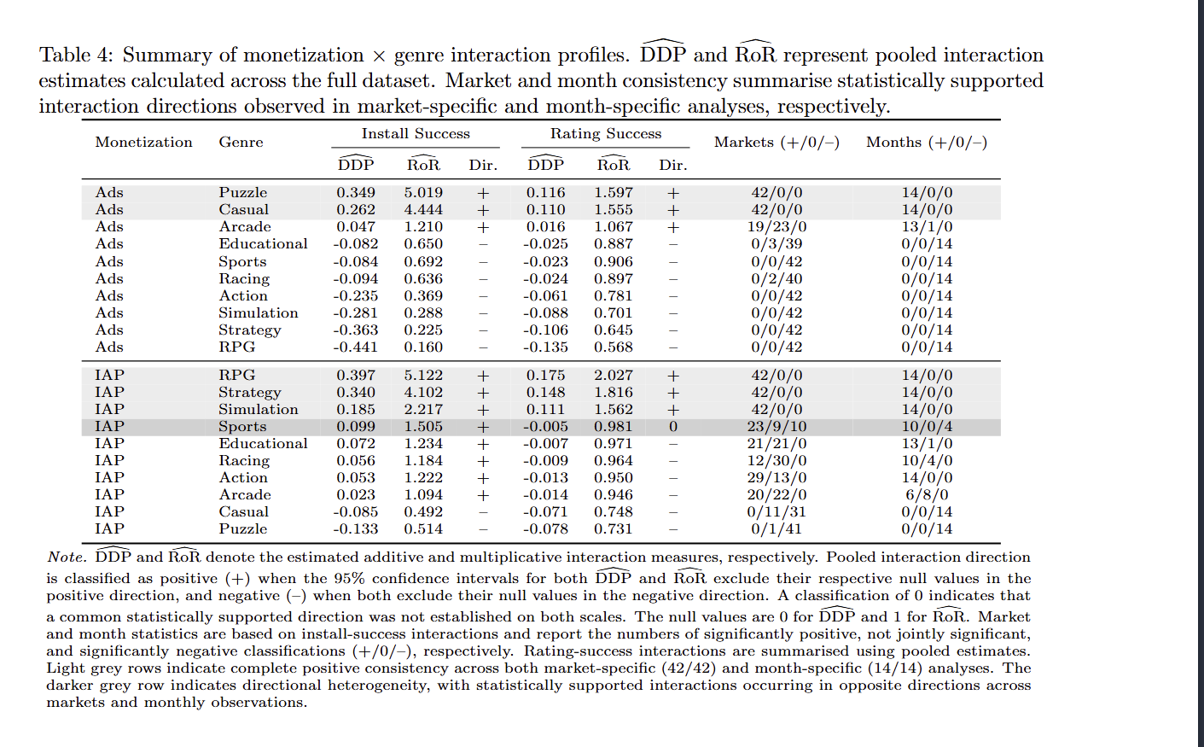

Slide 6
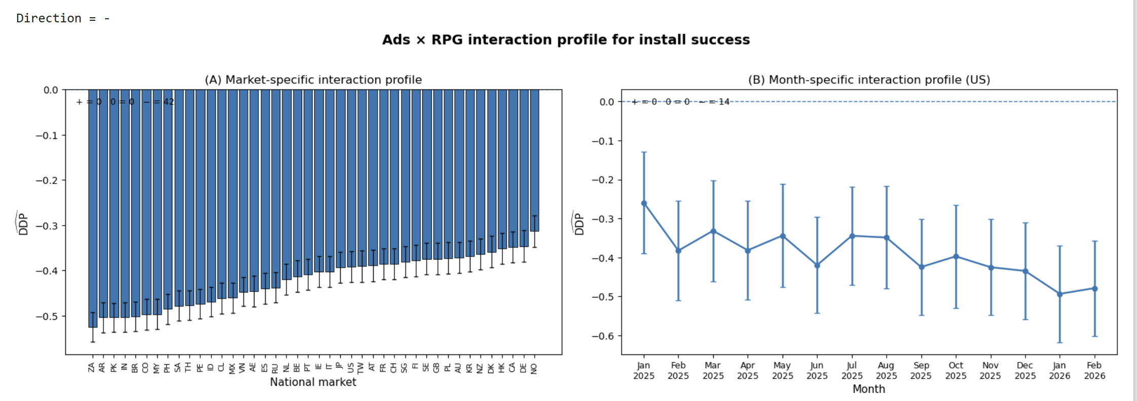
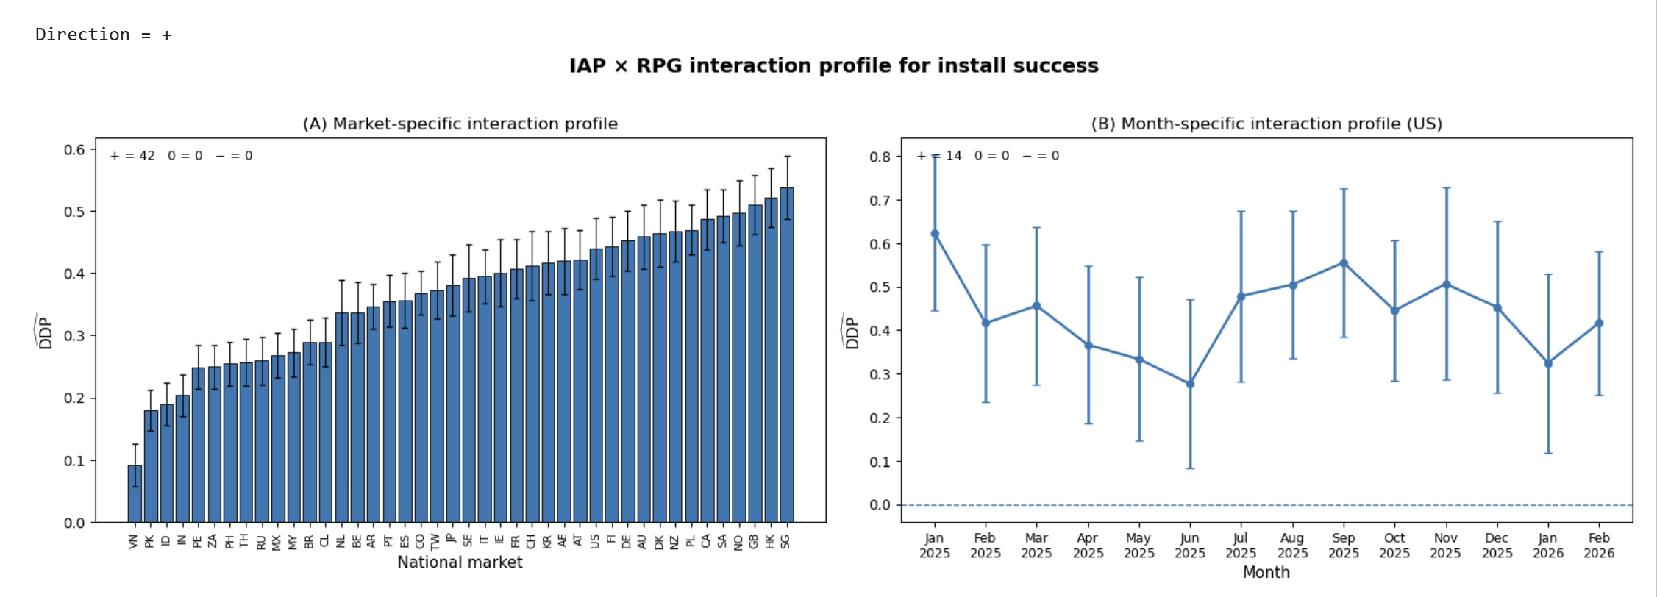

Slide 7
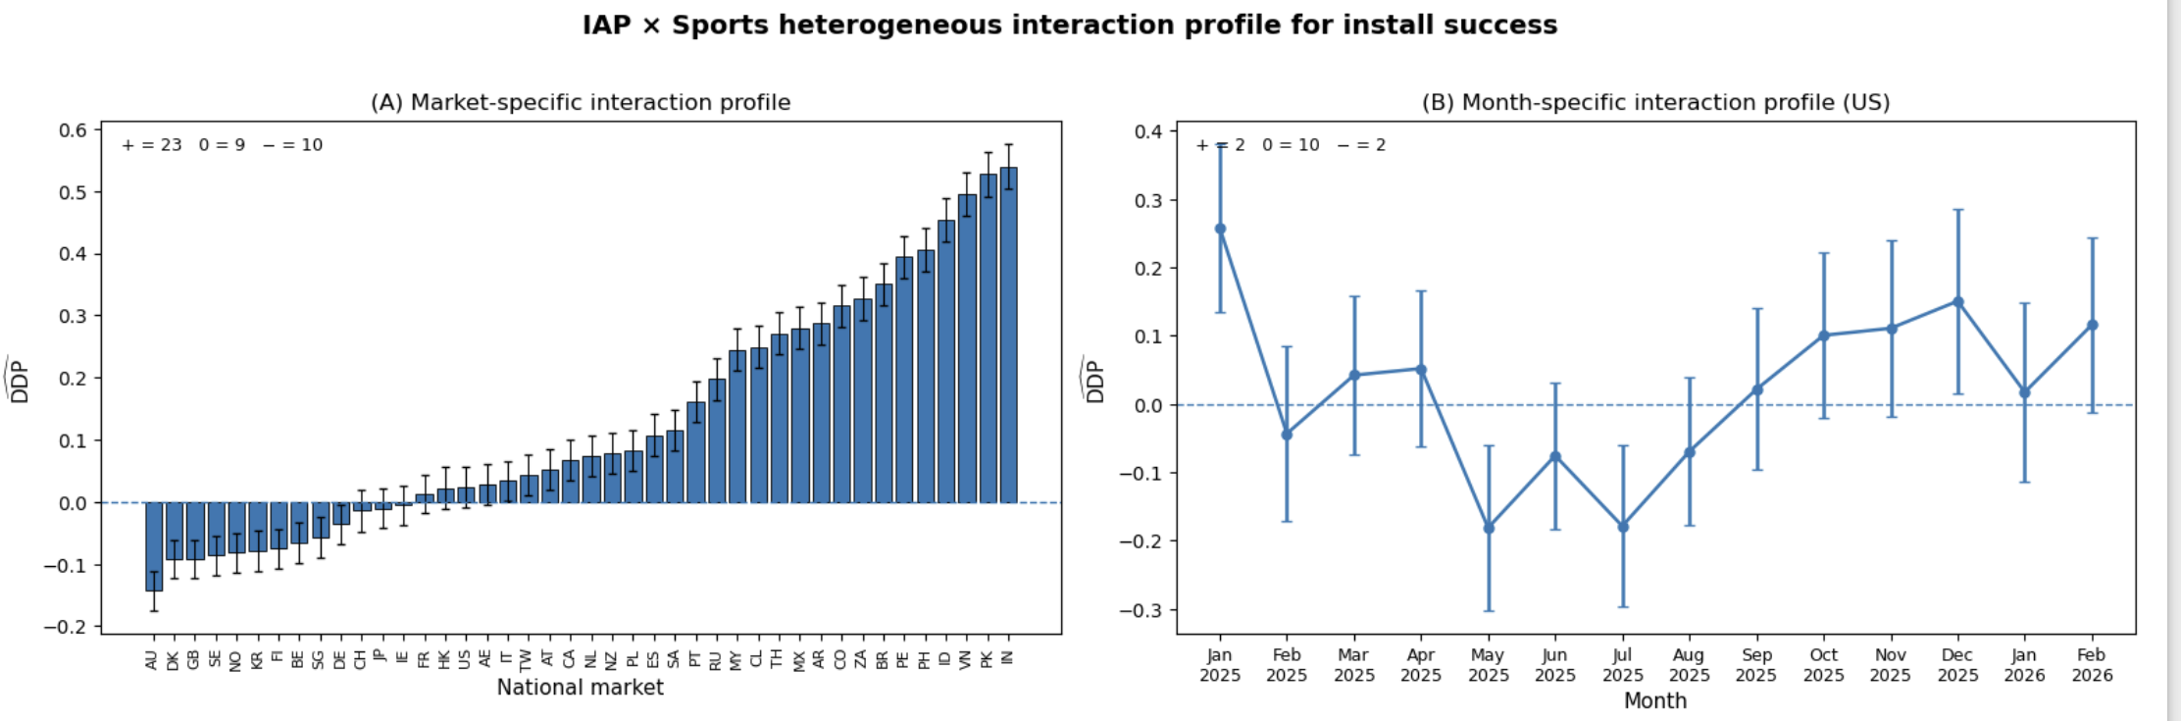

Slide 8
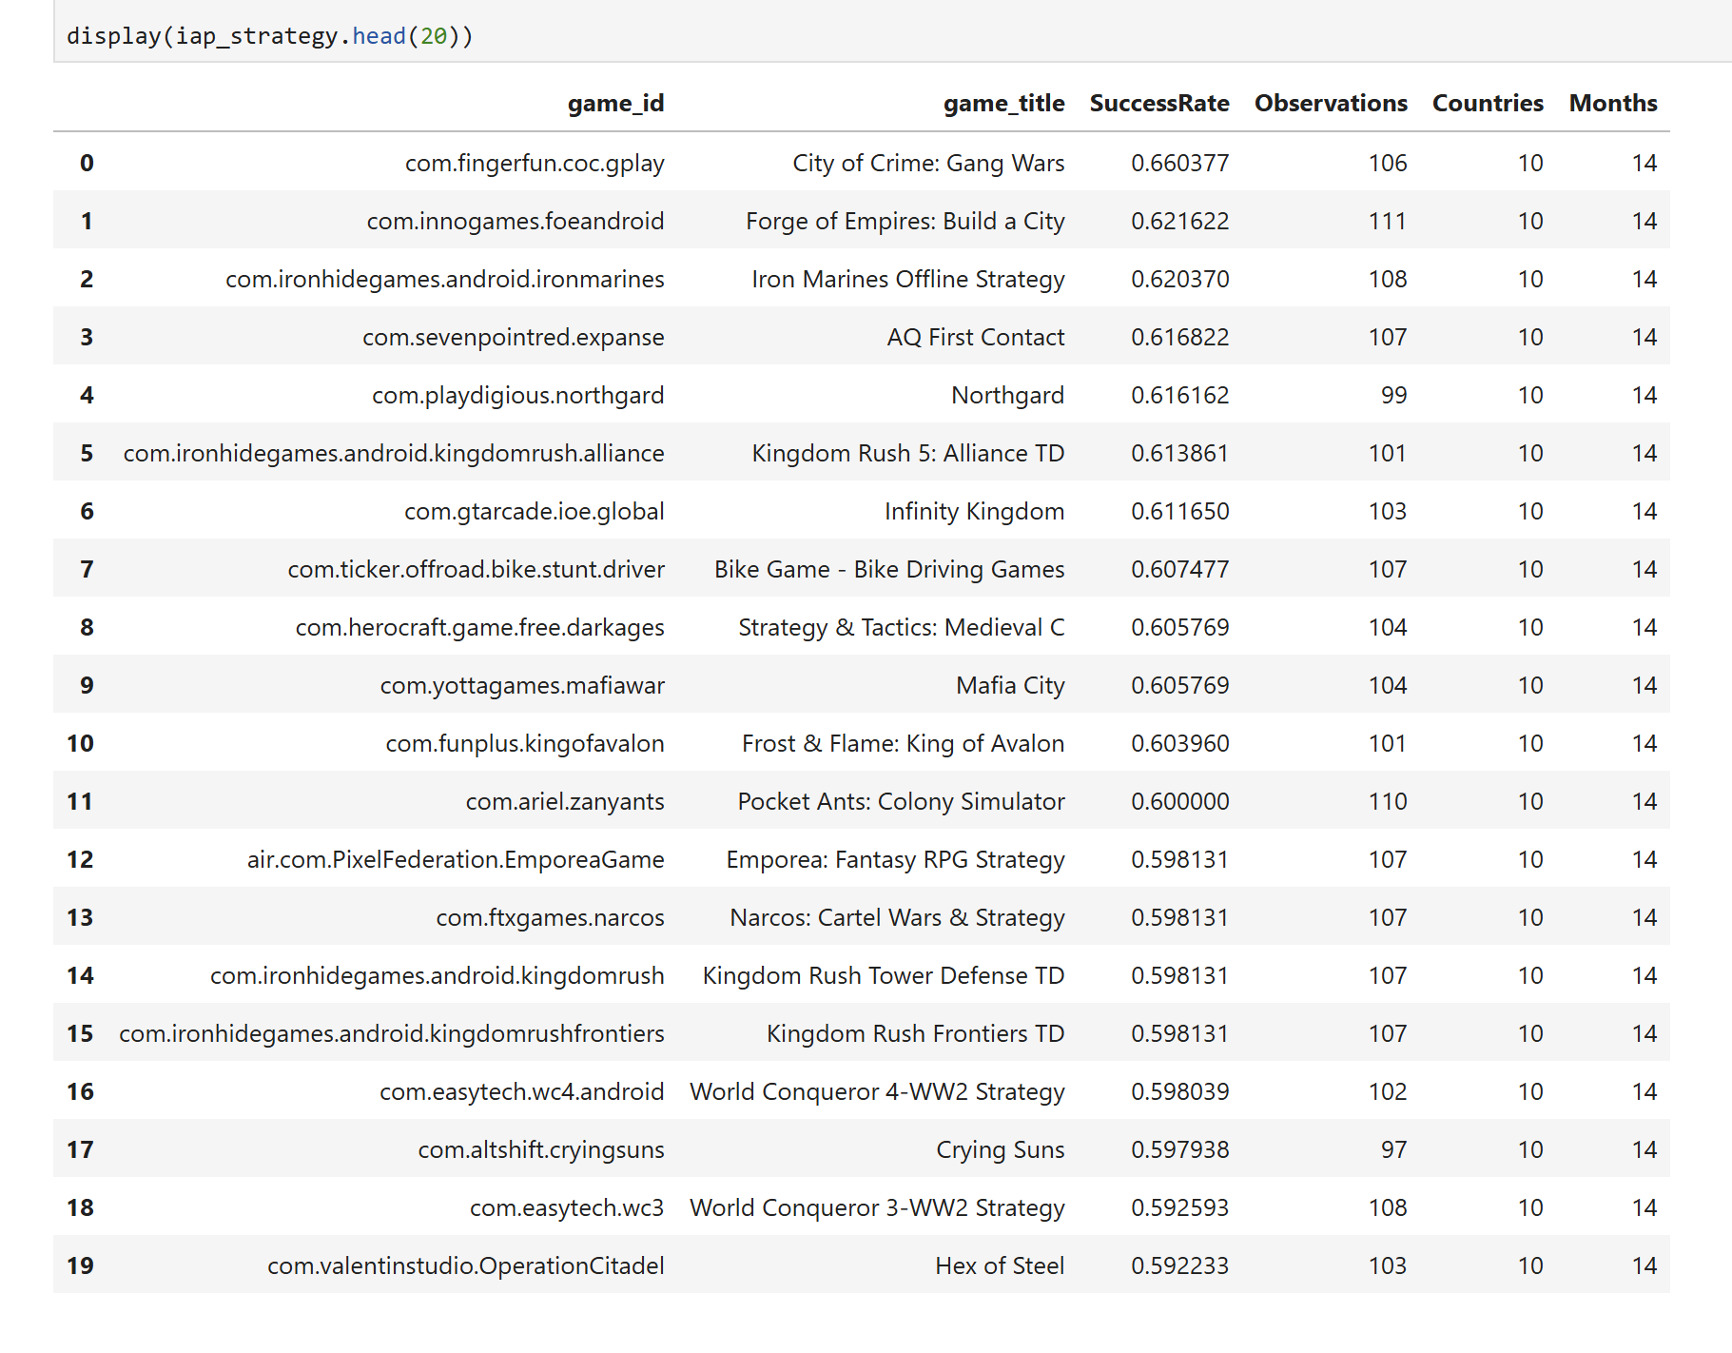

Genre Profile Characterization
IAP – oriented Genres
Strategy
P(Success | IAP, Strategy)
RPG
P(Success | IAP, RPG)
Simulation
P(Success | IAP, Simulation)
Interaction
How play is organized
Progression
How advancement unfolds
Reward
How value/rewards are structured
Session / continuity
Short/self-contained vs persistent
Genre → Forms of Play
Persistent progression – task based
uninterruptible gameplay
long-term progression

Slide 9
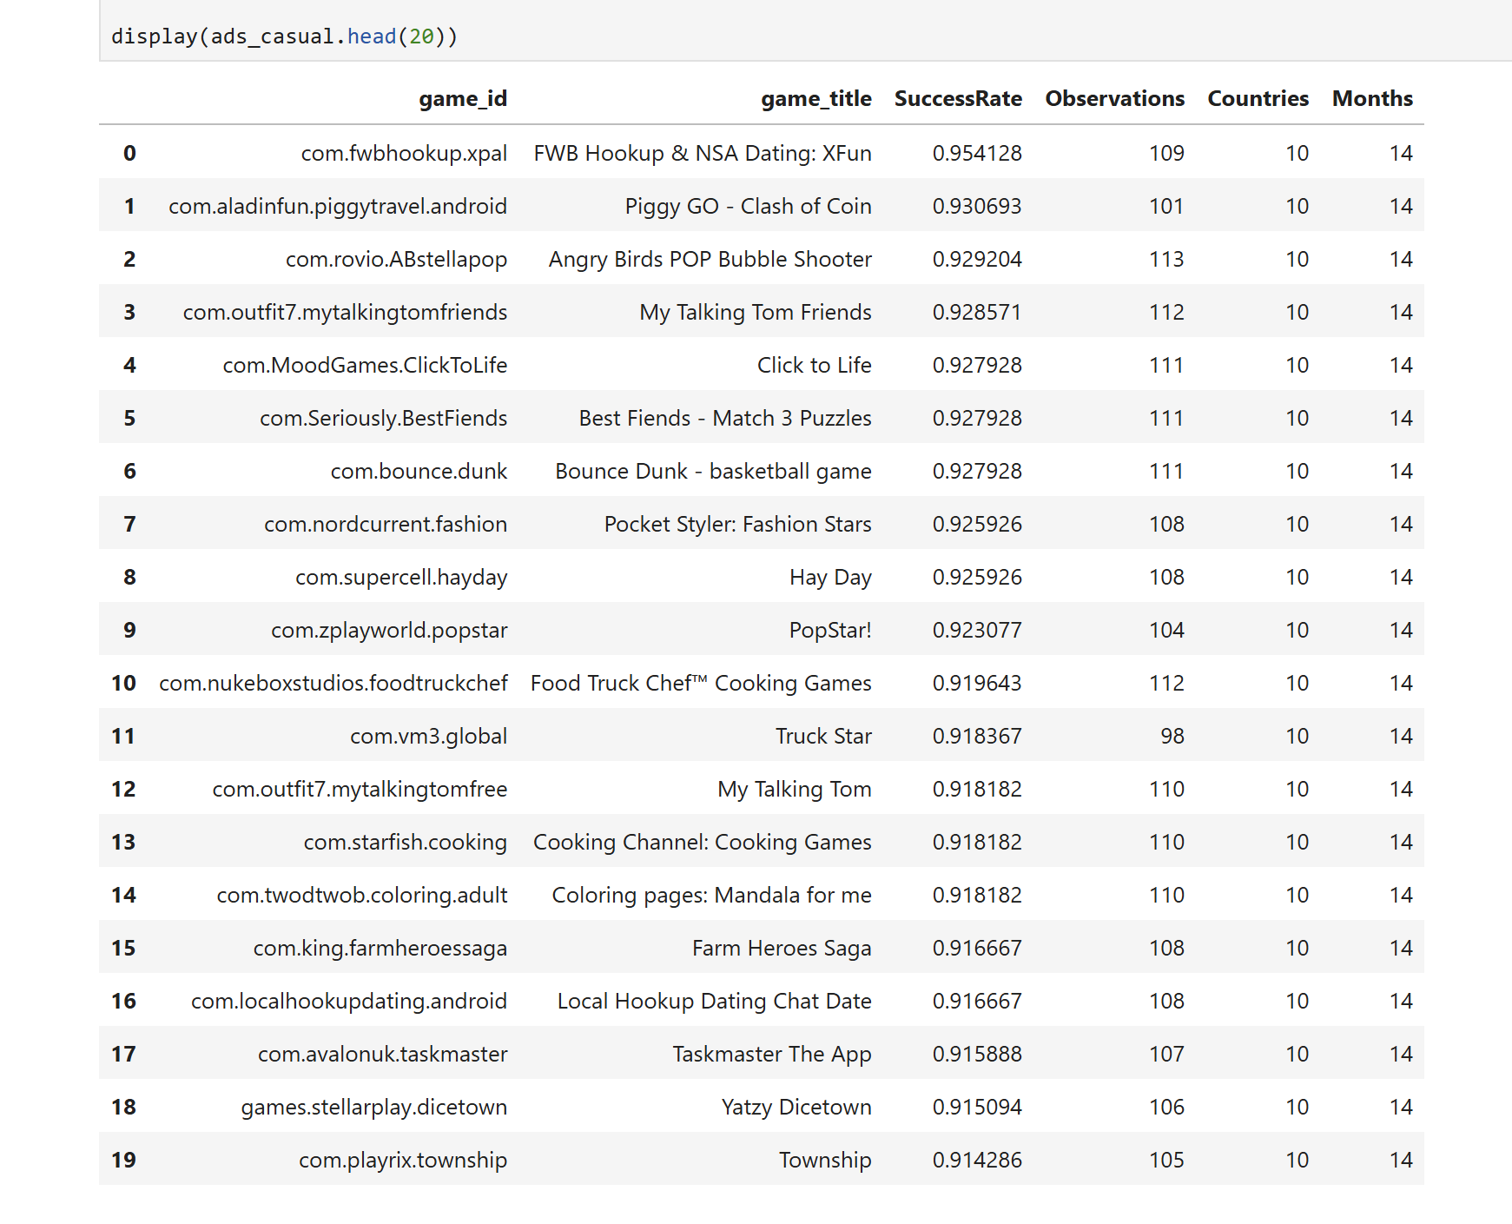
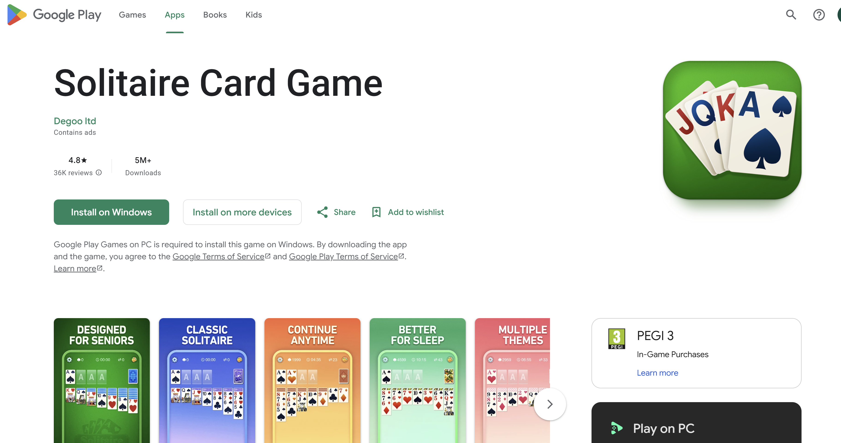
Ads – oriented Genres
Action
P(Success | Ads, Action)
Casual
P(Success | Ads, Casual)
Interaction
How play is organized
Progression
How advancement unfolds
Reward
How value/rewards are structured
Session / continuity
Short/self-contained vs persistent
Genre → Forms of Play
Level based progression
interruptible gameplay
self-contained play patterns

Slide 10
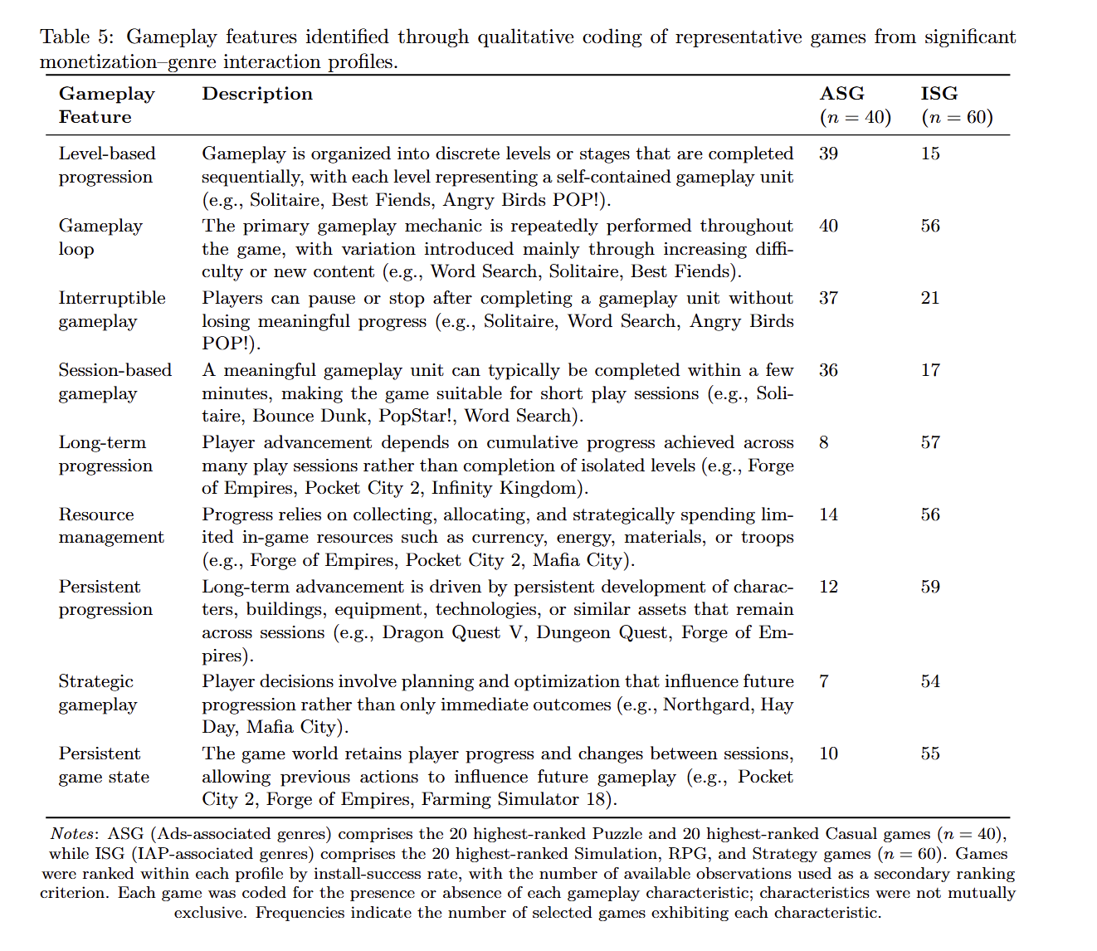
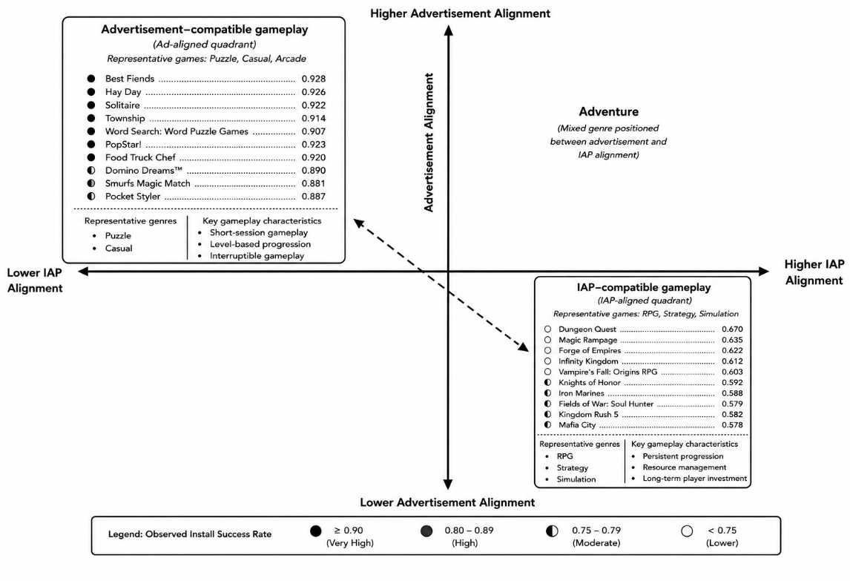
Recurring Profile
e.g., Ads × Puzzle
or IAP × RPG
Identify Successful Games
Within that monetization–genre profile
Gameplay Indicators
Apply the same indicator set
to the successful games
Form of Play
Interpret recurring
gameplay characteristics
Mont. × Genre → Installs & Ratings
(Form of Play)

Slide 11
CROSS-MARKET CONTEXTUAL CHARACTERIZATION
Recurring Monetization × Genre Profile
e.g., IAP × Strategy
Country-Specific Interaction Magnitude
DDP by country
Does variation in interaction magnitude correspond to national market characteristics?
Median Age
DDP × Age → ρ
PPP
DDP × PPP → ρ
HDI
DDP × HDI → ρ
Internet
DDP × NET → ρ
Digital Payment
DDP × DP → ρ
Spearman Rank Correlation
DDP × National Indicator → ρ
Repeat for all 5 recurring profiles → 5 profiles × 5 indicators = 25 associations p-values
Significant associations: pFDR​<0.05
Benjamini–Hochberg False Discovery Rate (FDR) procedure: 25 p-values → FDR​ → 25 pFDR​-values

Slide 12
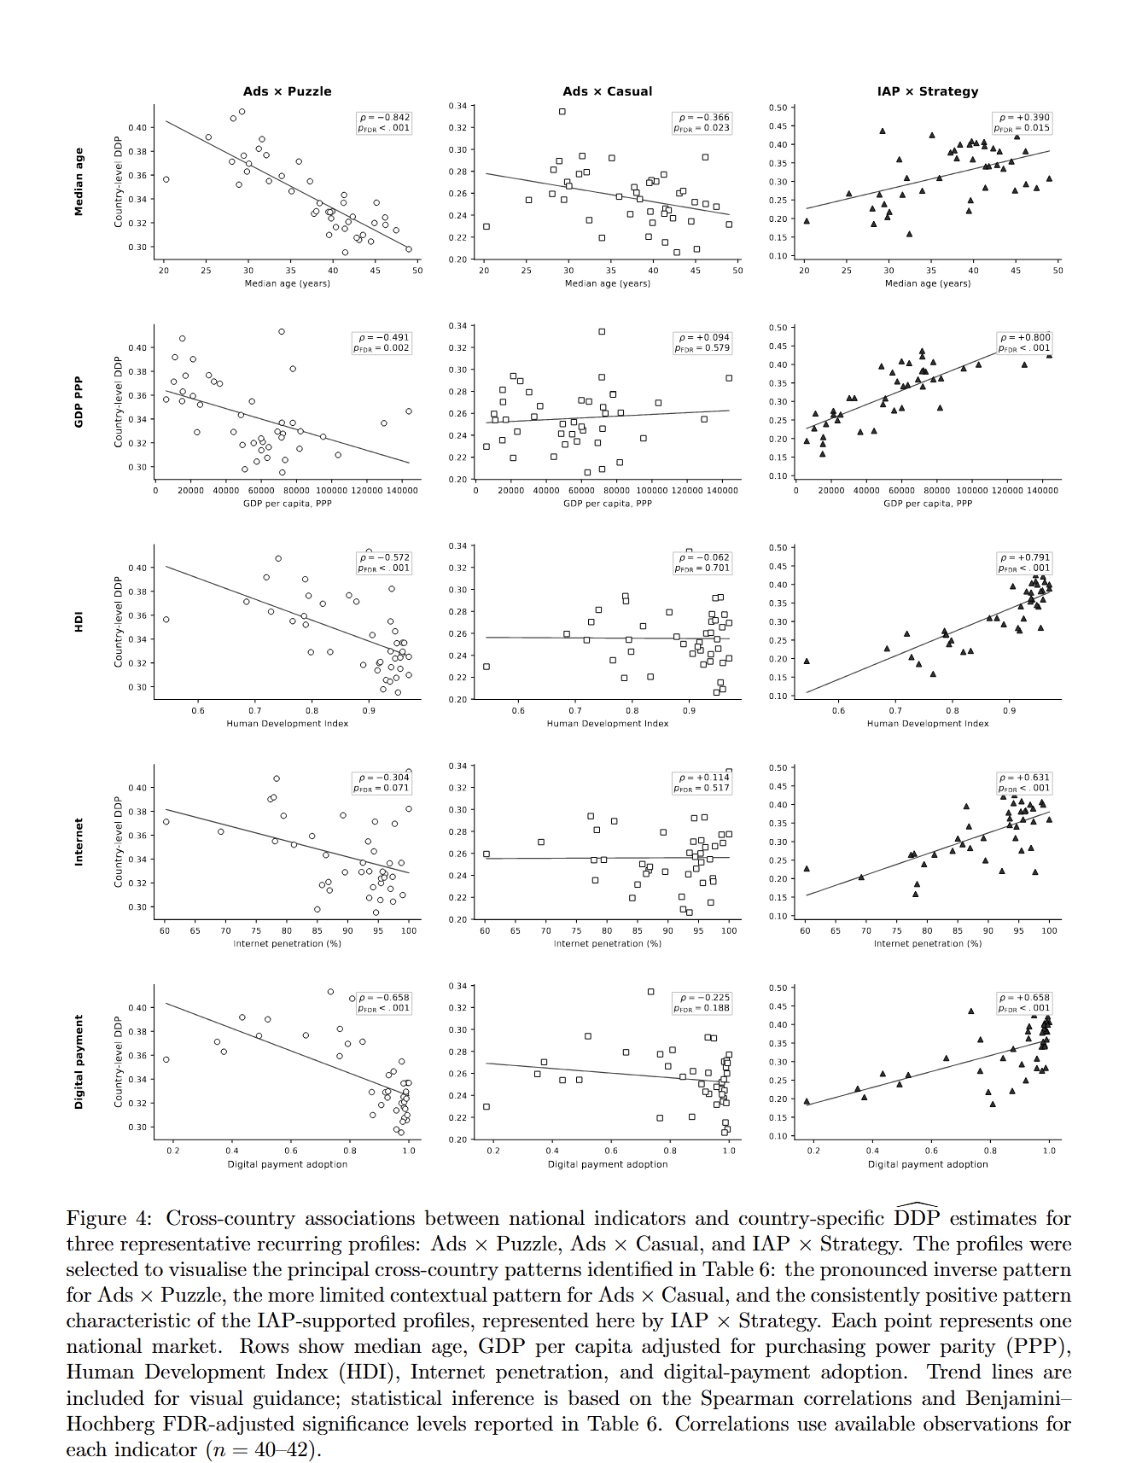
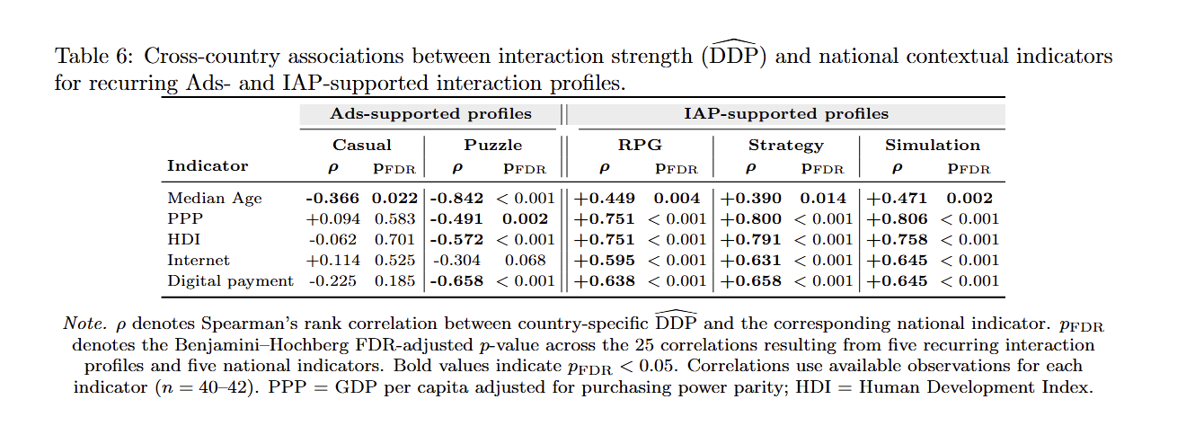
Ads-supported profiles
→ Stronger mainly in
  younger population and
  comparatively lower digital-payment markets
  → Pattern strongest for Puzzle
IAP-supported profiles
→ Stronger consistently in
  Older population,
  higher-purchasing-power,
  more developed and digitally enabled markets
  → Consistent across RPG, Strategy & Simulation

Slide 13
What We Now Do
1. Pooled interaction
Identify Monetization × Genre interaction profiles
2. 42-market replication
Test cross-market generalizability
3. 14-month replication
Test temporal stability
4. Gameplay characterization
Interpret recurring profiles as distinguishable forms of play
5. Market characterization
Relate magnitude differences to national context
Cultural Paradox of Success

Slide 14
Two findings that appear contradictory but can both be true at the same time.
It appears to be X overall, yet under different conditions it can also be Y.
Overall Acceptable
Monetization Practice
Do Country structure support?
A practice can appear successful overall while, at the same time, becoming unsuccessful under particular contextual conditions
Align with gameplay?
Under a particular context: The same monetization practice may have no benefit or even a negative relationship with success.

Slide 15
Cultural Paradox of Success
Finding that a practice works is only the first result. We need to identify the conditions under which it works.
ad frequency: Suppose an aggregate analysis shows that a certain ad frequency is associated with higher success. The immediate interpretation might be: “this frequency works.”
Therefore, the useful question is not only “Is this ad frequency successful?” but “Under what form of play does this ad frequency become successful?”
However, analysing variables together to test whether the relationship between the practice and success changes conditional on another variable
In this study, monetization is the practice.
We first ask whether the relationship of Ads/IAP with marketplace success is conditional on genre.
Genre provides the internal game context. It helps reveal whether monetization succeeds when it is aligned with particular forms of play,
Then we test it across 42 countries x 14 month time in each country
So the central idea is: a successful practice is not inherently successful; its success is conditional on its alignment with the context in which it operates.

Slide 16
What the Results Are Showing
Ads-oriented patterns
Stronger in Casual / Puzzle
Shorter, interruptible,
self-contained play
IAP-oriented patterns
Stronger in RPG / Strategy /
Simulation
Persistent progression and
resource investment
Across environments
Patterns recur across markets
and remain stable over time,
but magnitude differs
Ads stronger where…
younger populations and comparatively lower purchasing power / digital-payment participation
IAP stronger where…
greater purchasing power, development, Internet penetration and digital-payment adoption
5

Slide 17
How the Contribution Has Advanced
Methodological contribution
The Interaction-Analysis Framework is now demonstrated through a theoretically motivated, context-sensitive game research problem.
Empirical / conceptual contribution
Aggregate monetization patterns can recur broadly while retaining different significance across forms of play and marketplace environments.
Cultural Paradox of Success
Broad empirical regularity can coexist with systematic contextual differentiation.
6

Slide 18
DATA & DESIGN
Population
Focal Feature (r)
Context (c)
Outcome (y)
Estimation
1,778,700
game–market–month observations of free-to-play (F2P) Android games
Ads availability;
IAP availability — analysed separately
10 genres (one-vs-rest);
42 national markets;
14 months, Jan 2025–Feb 2026
Install success &
rating success
at or above the
country–month median
2×2 tables per stratum
→ conditional probabilities
→ DDP, RoR (95% CI)

Slide 19
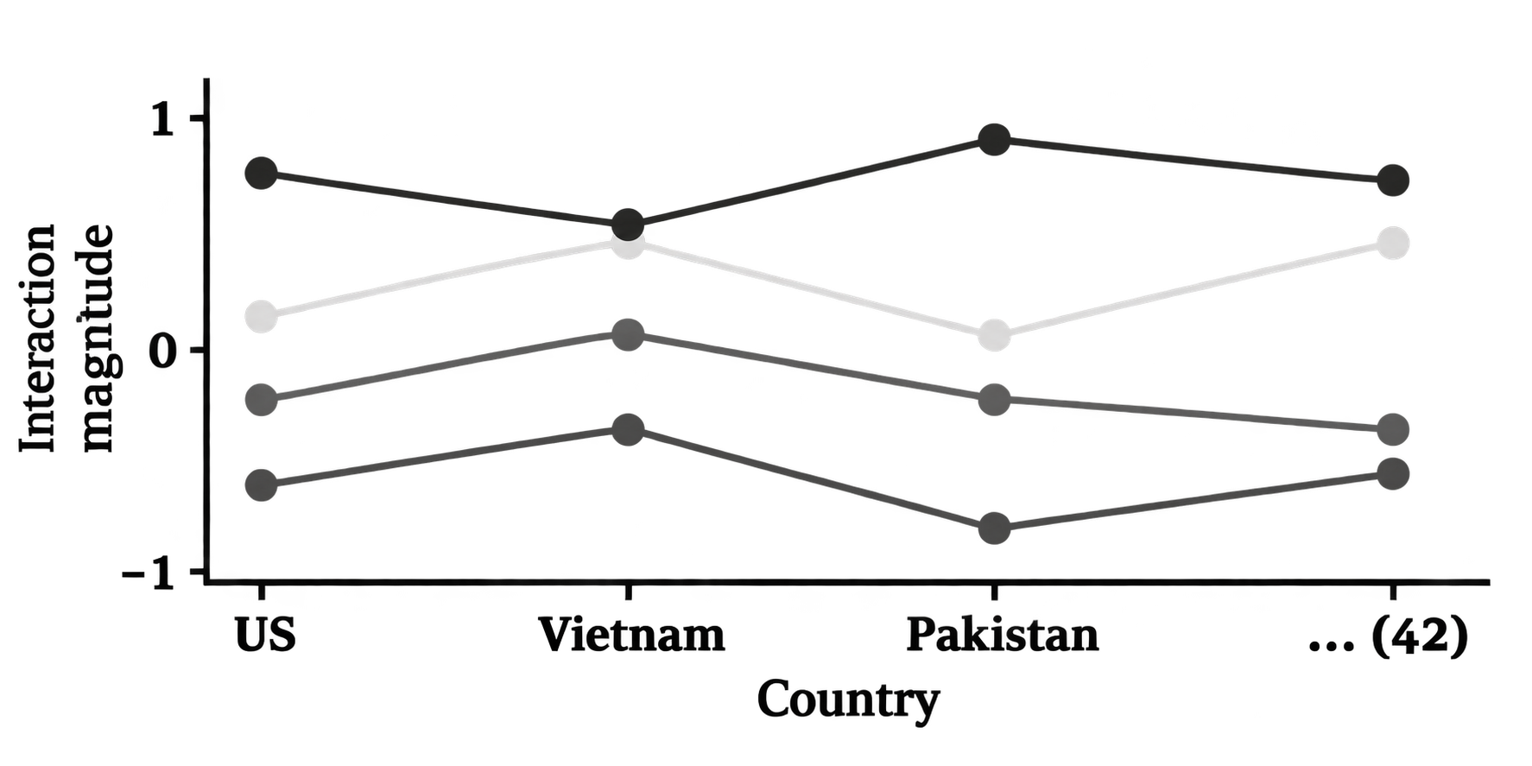













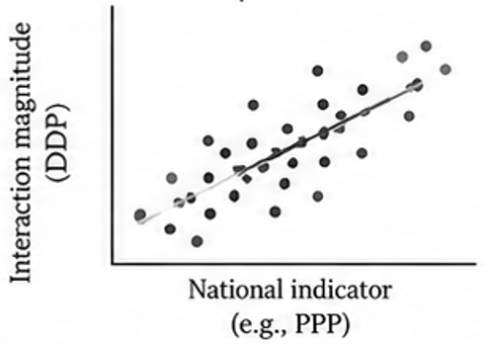
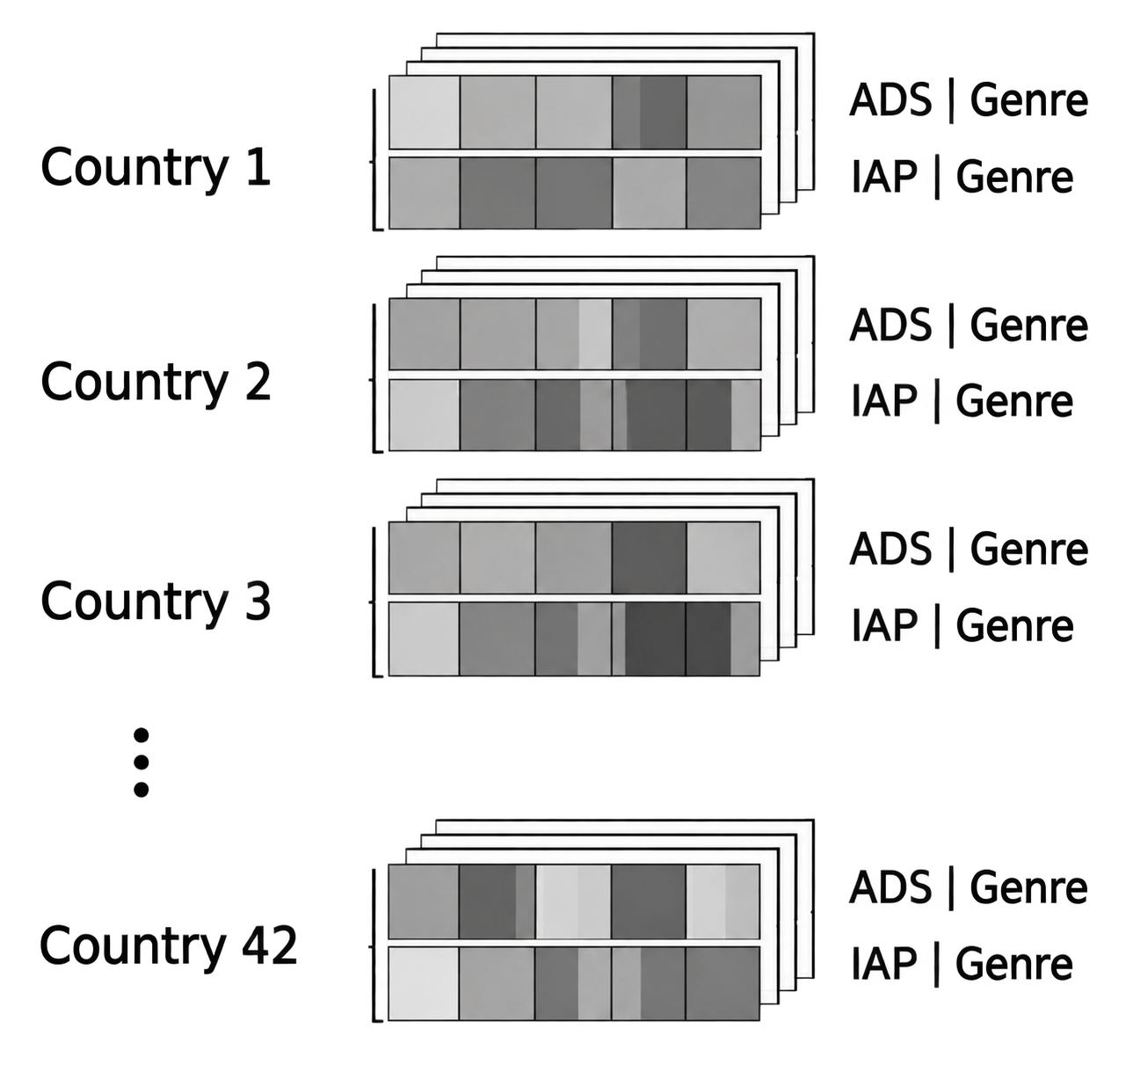
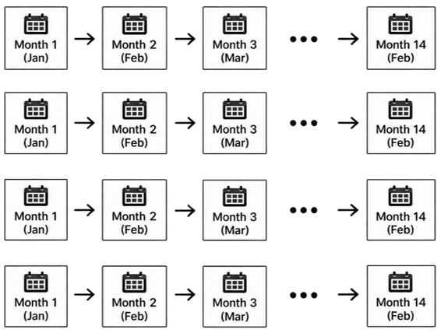
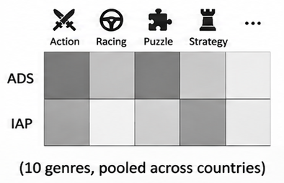
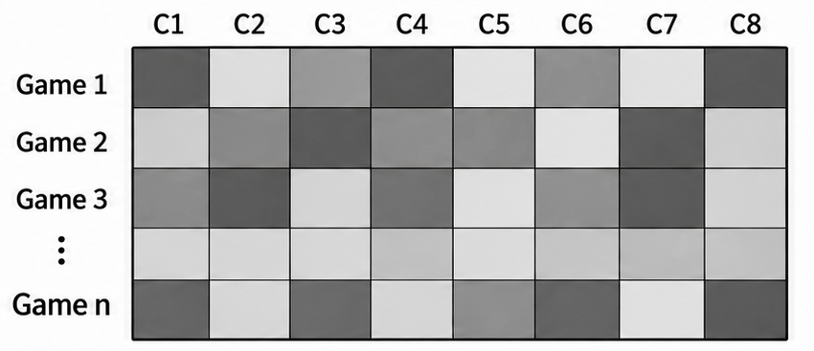
Stage 1
Stage 2
Stage 3
Stage 4
Stage 5
Does the monetization–success relationship vary across game genres?
2. Do these genre-conditional relationships recur across markets?
3. Do recurring country-specific relationships remain stable over time?
4. What gameplay characteristics characterize the underlying genre contexts
5. What national characteristics are associated with cross-market variations?
Genres carry their own expectations of mechanics, progression, and pacing, so genre is where one monetization practice meets different structures of play.
y ~ r | c
monetization × genre profiles, pooled;
Games ship the same design to different populations, so the national market is where one practice meets different conditions of access, payment, and reception.
y ~ r | c, C
Re-estimated within each of markets;
Titles age, games update, catalogues turn over. Without a temporal test, recurrence could be a snapshot of one market state.
y ~ r | c, C, T
Re-estimated within country–month strata across monthly periods.
Genre establishes that forms of play matter; reading the games themselves specifies which properties of play the recurring profiles are composed of.
profiles → forms of play
Markets differ in demographic, economic, developmental, and digital conditions, which may explain cross-market variation in monetization.
DDP₍C₎ ~
Age, PPP, HDI, NET, DP
Monetization
(Focal Feature)
Genre
(Contextual Modifier)
Estimates within each county
Estimate Within Each Country–Month
Ads Supported Profiles
IAP Supported Profiles
Country Interaction
Action
Puzzle
Ad
Racing
United States
United States
Strong Synergic
Strategy
Puzzle
Finland
Finland
RPG
IAP
Vietnam
Vietnam
Casual
Strategy
National Indicators
…. 10 Genres
Pakistan
Pakistan
RPG
…. 42 Countries
…. 42 Countries
Simulation
Casual
Puzzle
Marketplace Success (Outcome)
Strong Antagonistic
Strategy
Spearman’s rank correlation (ρ)
High Installs
High Ratings
Interaction profiles per country
Interaction profiles per country-month
Each dot represents game in that profile
Extract Gameplay Info:
Estimate Interactions
ROR & DDP
i. Organization of Play (What the player does)
ii. Progression & Persistence
(What develops or carries forward))
iii. Overall Form of Play
(How these elements operate together)
95 % CI
Benjamini–Hochberg FDR correction
Significance: q<0.05

Slide 20
OUTPUT & RESULTS
Output 1: Genre Conditional Relationships
Output 2: Cross Market Estimates
Output 3: Time Specific Market Estimates
Output 4: Genre to Inside Gameplay
Output 5: National Contextual Variation
Final Synthesis: Contextual Scope of Monetization–Success Relationships
Forms of Play × National Markets × Time × National Conditions

Slide 21
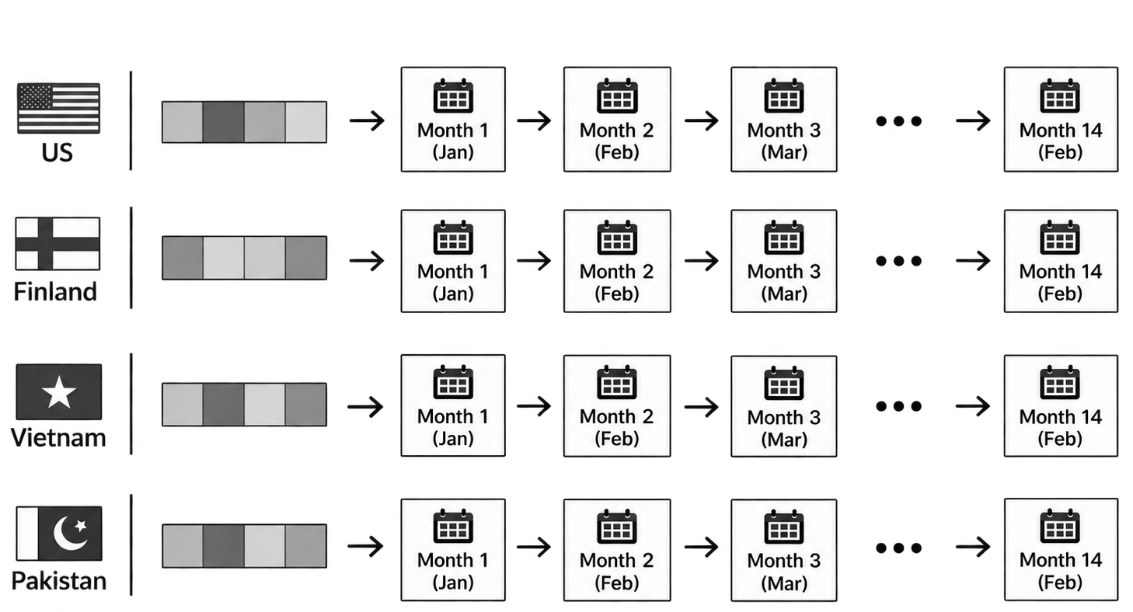
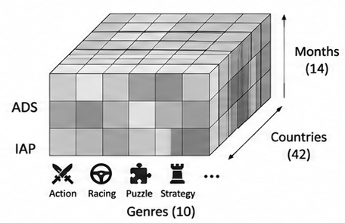
Stage 1
Does the monetization–success relationship vary across game genres?
Monetization
(Focal Feature)
Marketplace Success
(Outcome)
Ad Availability
IAP Availability
95 % CI
High Installs
Estimate Interactions
ROR & DDP
Genre
(Contextual Modifier)
Action
Strategy
High Ratings
Racing
Strategy
Puzzle
Output 1: Genre Conditional Relationships
( Success | Monetization , Genre ) Estimates
…. 10 Genres
Stage 2
Stage 3
Do these genre-conditional relationships recur across national markets?
Do recurring country-specific relationships remain stable over time?
Estimate Within Each Country–Month
Country – Months
Monetization–Genre Interaction Profiles
Estimates within each county
United States
Finland
Vietnam
Pakistan
….
42
Countries
Interaction profile per country
4 profiles per country - month
DDP – installs
DDP – ratings
ROR – installs
ROR – ratings
( 4 profiles per country, DDP – installs, ratings and ROR – installs, ratings )
…. 42 Countries
Output 2: Cross Market
Estimates
Output 3: Time Specific Market Estimates

Slide 22
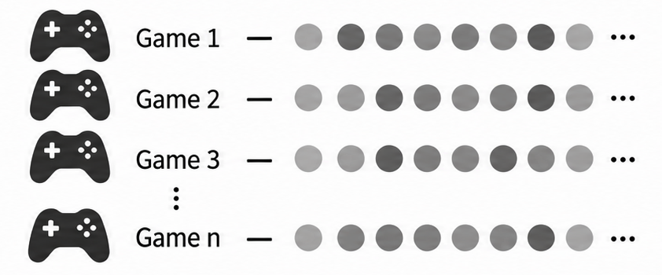
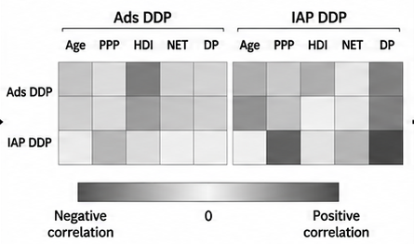
Stage 4
What gameplay characteristics characterize the genre contexts underlying recurring monetization–success relationships?
Strong Synergic
Strong Antagonistic
Analyze Each Game to Characterize Gameplay
Ads Supported Profiles
Puzzle
Strategy
Casual
RPG
….
Within each profile
Strong Synergic
Strong Antagonistic
RPG
Simulation
IAP Supported Profiles
Casual
Puzzle
Extract Gameplay Info:
Strategy
i. Organization of Play (What the player does)
ii. Progression & Persistence (What develops or carries forward))
iii. Overall Form of Play (How these elements operate together)
Output 4: Synthesis of Recurring Characteristics
(Genre – to – Gameplay)
Each dot represents game in that profile
Stage 5
What national characteristics are associated with cross-market variations?
Country Interaction
Spearman’s rank correlation (ρ)
Benjamini–Hochberg FDR correction
National Indicators
Significance: q<0.05
Output 5: National – Context
patterns of monetization interaction

